Slide 1

RAMAIAH INSTITUTE OF TECHNOLOGY BENGALURU - 560054
SEMESTER END EVALUATION FOR PROJECT WORK on
IS715 – Project Preliminaries
DEPARTMENT OF INFORMATION SCIENCE AND ENGINEERING

Slide 2

SMART PARKING SYSTEM USING RFID TECHNOLOGY
SACHIN POOJERI – 1MS14IS090
SHUBHAM PAWAR – 1MS15IS418
MD ABDUL AHAD CHANDA – 1MS14IS061
SACHEEN ISHWAR ADAVINAVAR – 1MS14IS089
Supervisor: Mohan Kumar S.

Slide 3
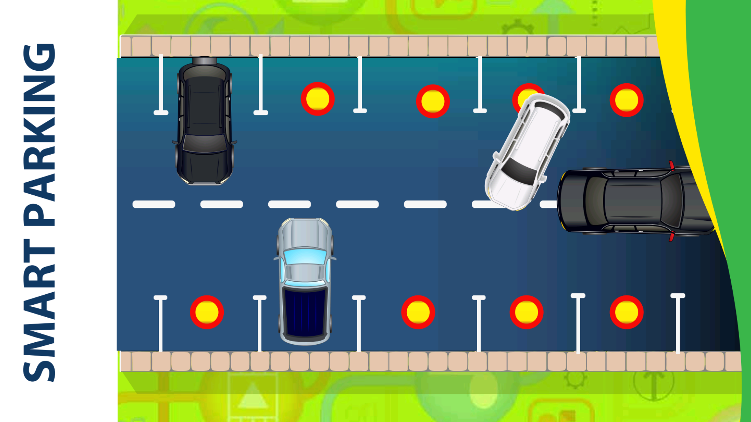

Slide 4
Introduction
Radio frequency identification is a technology that helps to identify the animate or inanimate through radio waves .
The technologies like RFID readers, RFID writers, RFID barcode scanners, RFID smart sensors and RFID controllers include a wide range of automation technologies.
In this project, The software has been handled for the management , controlling, transaction reporting and operation tasks for parking lots located on various parts of the city . Check-ins and check-outs of the parking-lots will be under control with RFID reader labels and barriers.

Slide 5

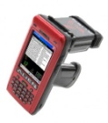










SYSTEM ARCHITECTURE
RFID Park 1
TAG READER BARRIER PC
RFID Park 2
Internet
Database Server
TAG READER BARRIER PC
RFID Park 3
TAG READER BARRIER PC

Slide 6






RFID Tag
Database
SYSTEM DESIGN
RF Power
RFID Antenna
Digital Signal
Personal Computer
RFID Reader

Slide 7
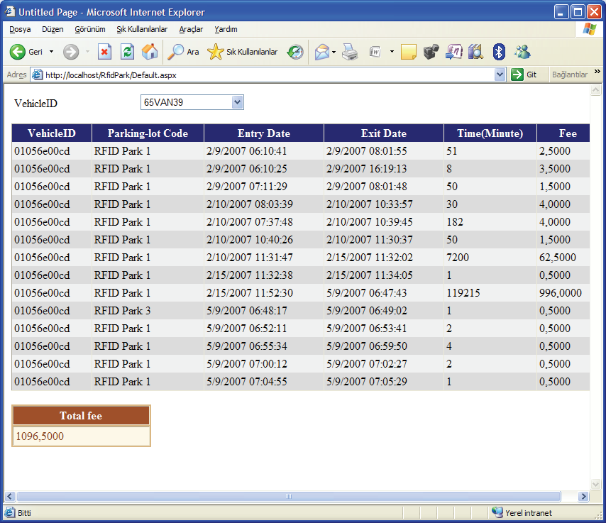
Accessing vehicle information panel through the web interface.

Slide 8
SYSTEM ANALYSIS
U.S. Smart parking system market revenue by parking site,2013-2024

Slide 9
According to a report, Smart Parking could result in 2,20,000 gallons of fuels saving till 2030 and approx. 3,00,000 gallons of fuels saved by 2050 , if implemented successfully .

Slide 10
Challenges and major pain points:
System integration due to wide variety of hardware and software platforms involved.
Great threat or concern to the system scalability.
The electronic payment vendors as processors provide permit based electronic payment, typically for a convenience fee.
Scalability and ability of the transaction processor to support over wide geographical, market and service areas, with minimal cost.

Slide 11
Indian Specific Ecosystem Challenges
Absence of a robust billing platform leading to possible revenue leakages.
Interoperability between devices/lack of standards .
Smart parking does not really provide much solution to two wheelers as yet in India.
Various Security issues and threats to the installed on-site parking meter as System is Unmanned .
The RFID enabled Parking System shall support mechanisms to correlate charging data/records from different RFID Application Service Providers.
The RFID enabled Parking System shall support triggering M2M Devices to report on-demand information regarding collected data from other M2M Devices

Slide 12
Flow charts
Check-in Point
Check-out Point
Read Vehicle ID
Read Vehicle ID
Is the vehicle registered?
Do not open the gate
Is the vehicle registered?
Register the vehicle info to the Database
Did the vehicle check -in?
Did the vehicle check -in?
Do not open the gate
Database
Database
Read vehicle info
Read vehicle info
Store check-in info
Update check-out info
Open the gate
Close the gate
Open the gate
Close the gate

Slide 13
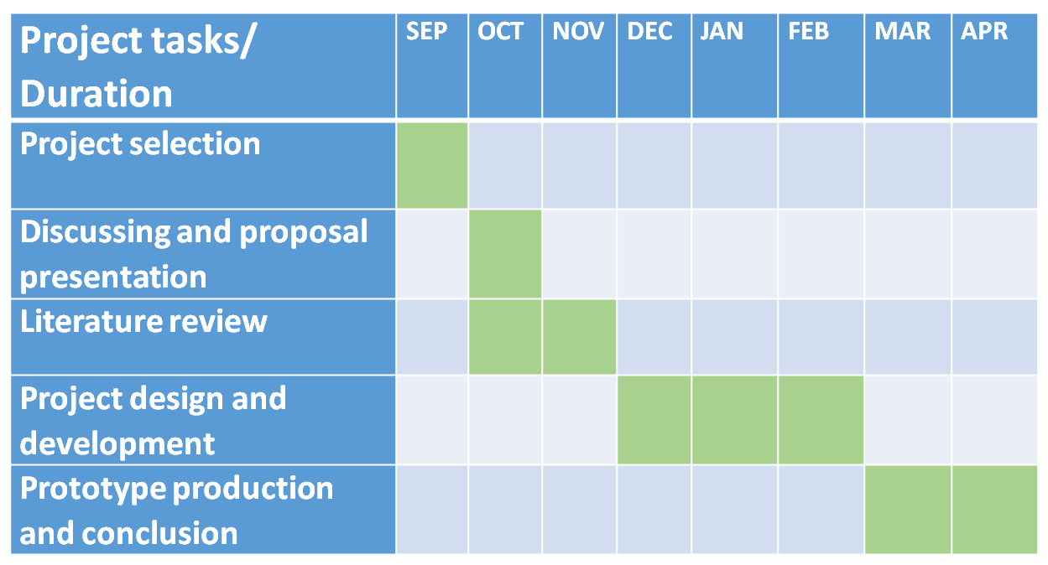
GANTT CHART

Slide 14
References
Reference websites:
http://whitepapers.zdnet.co.uk /0,1000000651,260090942p,00.html
http://supplychain.ittoolbox.com /blogs /featuredentry.asp
Reference books:
Anonymous, 2005. Electronic tolling technology & implementation. Richmond
Arnott, R., Rowse, J., 1999. Modeling parking, Journal of Urban Economics 45, pp. 97–124.
Banks, J., Pachano, M., Thompson, T., Hanny, D., 2007. RFID Applied. 299. John Wiley & Sons.

Slide 15
SUMMARY
Introduction
System Architecture
System Design
System Analysis
Algorithms and Flow Chart
References

Slide 16
THANK YOU

